Slide 1
Saving Energy & Money
James Oswald
Member Cosby Golf Club
Member Institute of Power Engineers

Slide 2
Contents
Heating Clubhouse
Electrical Clubhouse
Greens shed
Cost & Savings

Slide 3
Clubhouse heat

Slide 4
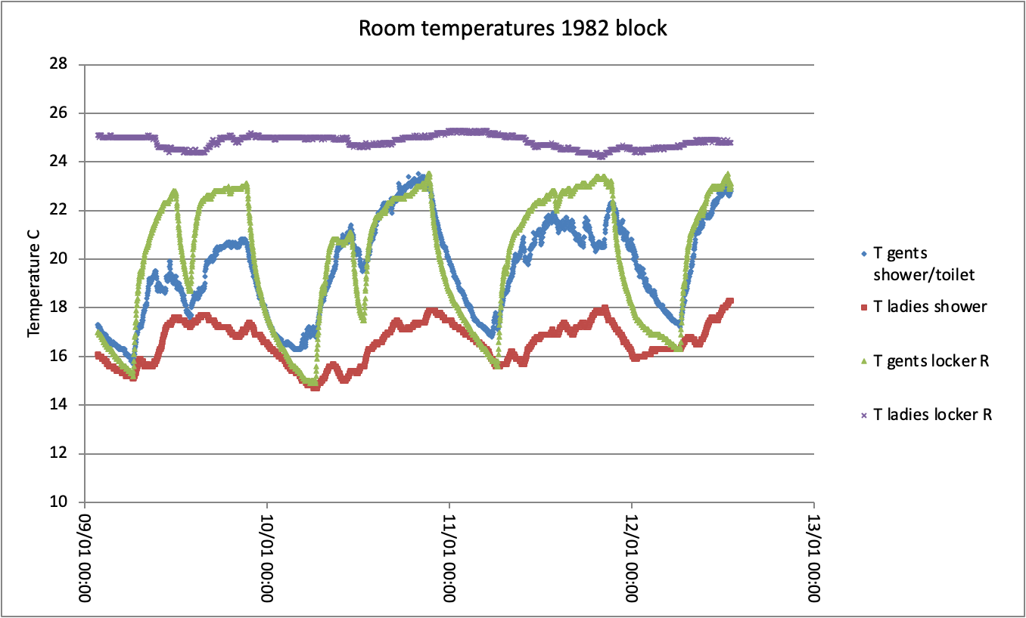
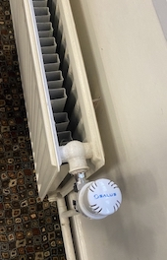
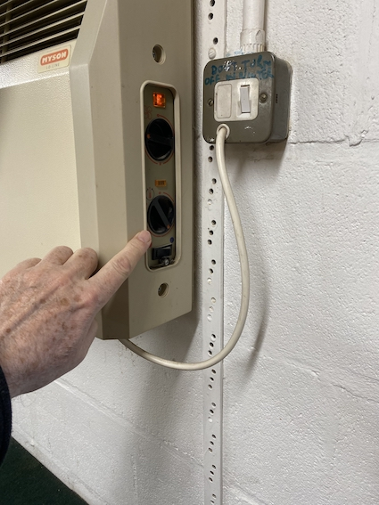
Measure clubhouse temperature
Measured room temperatures
Members turn everything to maximum or off
Stuck radiator valves
Broken heater (nobody checks)

Slide 5
Clubhouse electricity

Slide 6
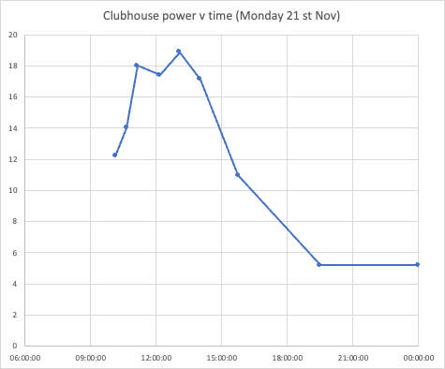
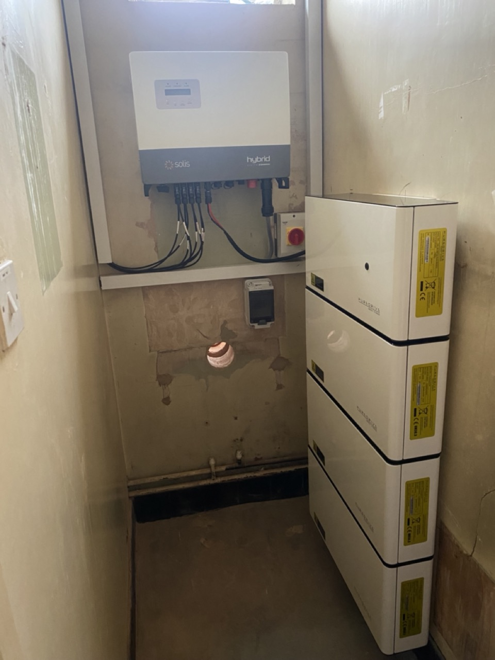
Clubhouse electricity
Read meter every hour
Peak during sunshine
Peak power 19kW
Install a 30kW system
Batteries are optional
Costly & space
More panels may be better

Slide 7
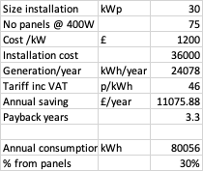
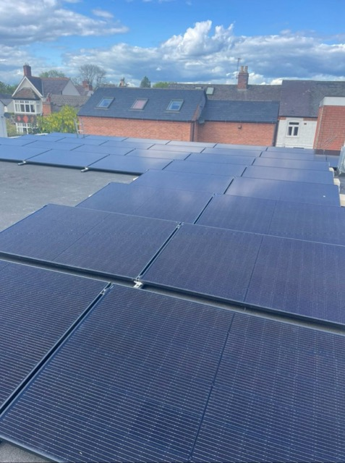
Clubhouse PV
Cost £1000/ kW installed
30kW system costs £30000
Battery or not?
I suggest not – peak at midday
Spend money on more panels
They will advise battery
Can divert power to hot water
2026 electricity price ~30p/kWh

Slide 8
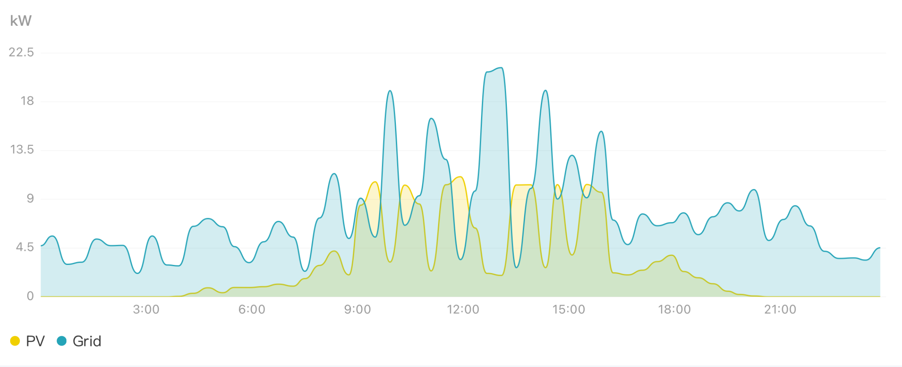
Clubhouse PV - 14th June 2025, cloudy
Grid imports (blue
PV
Grid

Slide 9
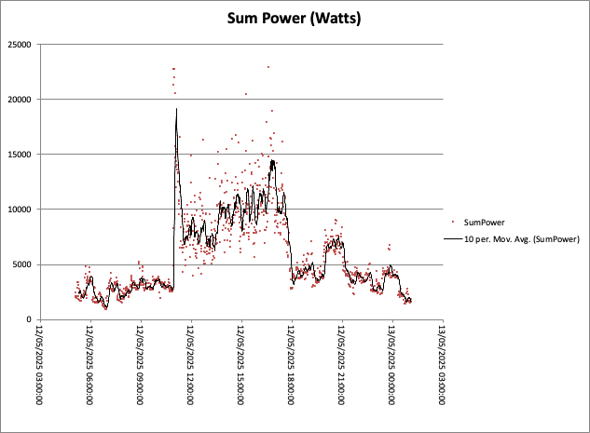
Clubhouse PV result
Peak power is reduced

Slide 10
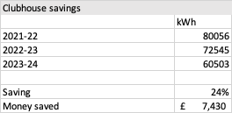
Clubhouse Savings
Savings from:
Solar panel
LED lights
Air conditioning unit in the pro shop

Slide 11
Greens shed

Slide 12
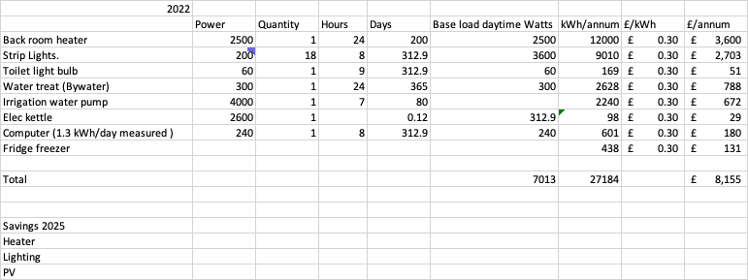
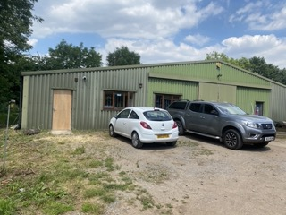
Greens shed
LED
Solar Panels
Air con heating/cooling

Slide 13
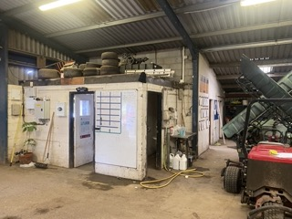
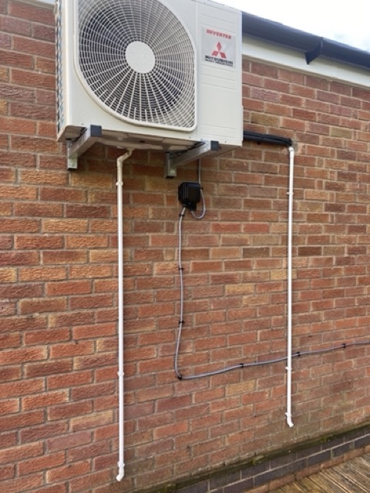
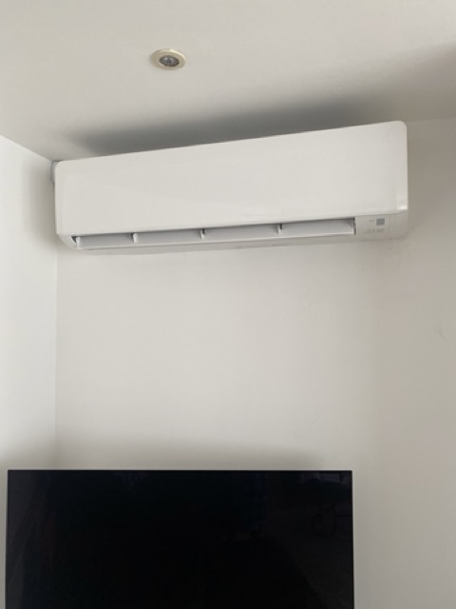
Cosby Greens Shed
Calor gas heating before
Air con after

Slide 14
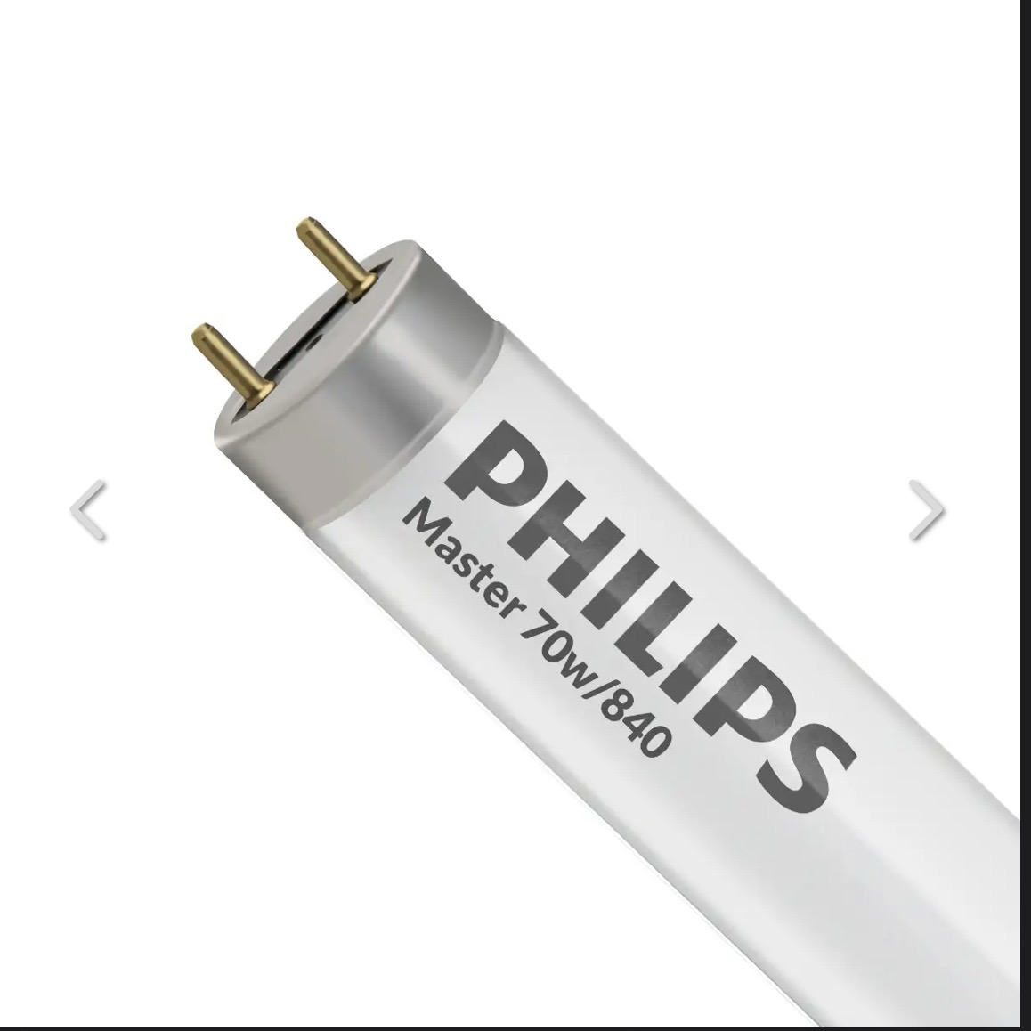
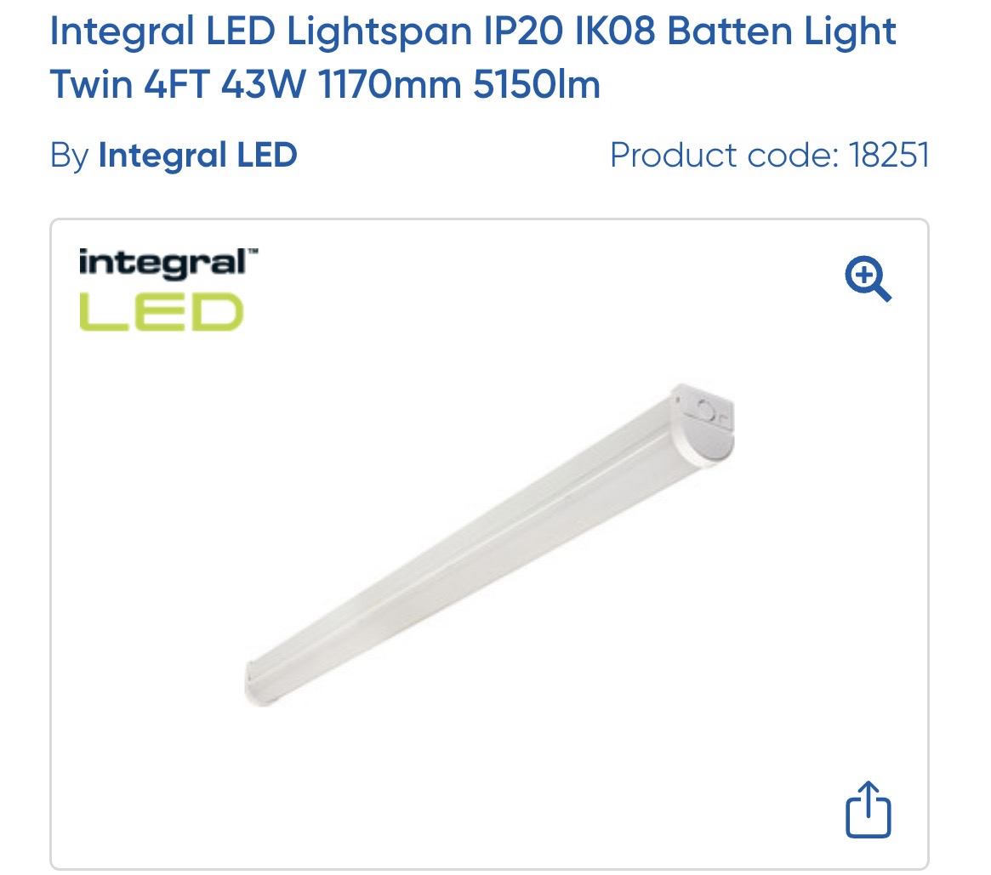
LED
Versus 6200 lumens fluorescent 70W
Lumens 5150 lumens LED, 43W

Slide 15
Recommendations
Heating
Inspect system and measure temperatures
Electrical
Make a list all electrical appliances – asses £
Install LED lights throughout
Install air con for heating
Don’t use electric direct heaters
Solar PV panels
Measure consumption of clubhouse and correctly size
Replace old refrigeration for cellar

